Slide 1
Gas Transmission System Operator Unbundling Process 2018-2020
Sergiy Makogon
December 18, 2019

Slide 2
TSO LLC has 2-level management structure with marginal headcount of 11,100 FTE
EU approved
CEO
1 level [TSO HQ]
Technical
Operations
Commercial & Business
Development
Administrative reporting directly to CEO
Financial Division
IT/OT
Gas dispatching
Strategy & regulatory
Procurement
Finance & accounting
Operations, maintenance & repairs planning & supervision
Metrology
Commercial dispatching
Legal
Sales, contracts & customer service
Corporate communications
Development, investment planning & supervision
Administration, security & qualified info mngmt
International affairs & foreign representatives
HR & HSE
Audit, risk & compliance
2 level [LPU]
LPU 1
LPU 1
LPU 2
LPU 2
…
…
LPU 20
LPU 20
All TSO functions are in place
TSO LLC is currently working on long-term optimization plan in order
to align TSO headcount with EU benchmarks

Slide 3
In order to ensure business continuity of transmission services, contractual campaign has been already started by TSO LLC (1/2)
Revenue contracts
Transmission contracts concluded by TSO LLC @ 16 Dec 2019
(number of contracts)
Concluded @ 17 Dec |  | Target | %
Shippers | 273 | ≈ 393 | 69%
Production companies | 49 | 62 | 79%
Supply companies | 29 | 32 | 91%
Non-residents | 18 | ≈ 42 | 43%
Direct consumers | 7 | 95 | 7%
DSO | 3 | 44 | 7%
Total: | 379 | 668 | 57%
New transmission contracts have been already concluded by TSO LLC with the market players (coming into force on 01.01.2020)

Slide 4
TSO LLC is currently being negotiating inter-operator agreements (IAs) with adjacent TSOs and plans to finalize the process by 01 Jan 2020
Poland | Signed on 29 Nov
Hungary | Planned for signing by 19 Dec
Slovakia | Negotiations in progress
Romania | One IA signed, others - in progress
Moldova | Planned for signing by 20 Dec
Russia | Negotiations in progress
Belorussia | Negotiations in progress

Slide 5
In order to ensure business continuity of transmission services, contractual campaign has been already started by TSO LLC (2/2)
Cost contracts
Contracts to be transferred to TSO LLC @ 01 Jan 2020
(number of contracts)
Business continuity of TSO LLC operations will be ensured by the contracts transferred from UTG – regulatory enabler was established by Ukrainian Parliament
Liabilities accrued by 2020 will stay in UTG
 | # of contracts to be transferred
Utility services | 267
Security services | 85
Maintenance & repairs services | 46
Construction works and services | 37
Professional services | 19
Equipment services | 11
Spare parts | 7
Bank & insurance services | 5
Ecology & waste management | 3
Other | 16
Total: | 496

Slide 6
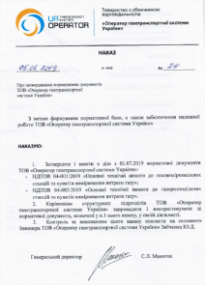
All internal documents needed for TSO LLC operation are developed and approved
Covered areas:
GTS operation (exploitation, maintenance & repairs, metrology, automation, HSE etc.)
HR (staffing table, job descriptions, departments’ profiles)
Internal operational & business processes
IT/OT
Finance & Accounting
Other
> 300
orders regarding TSO LLC core activities

Slide 7
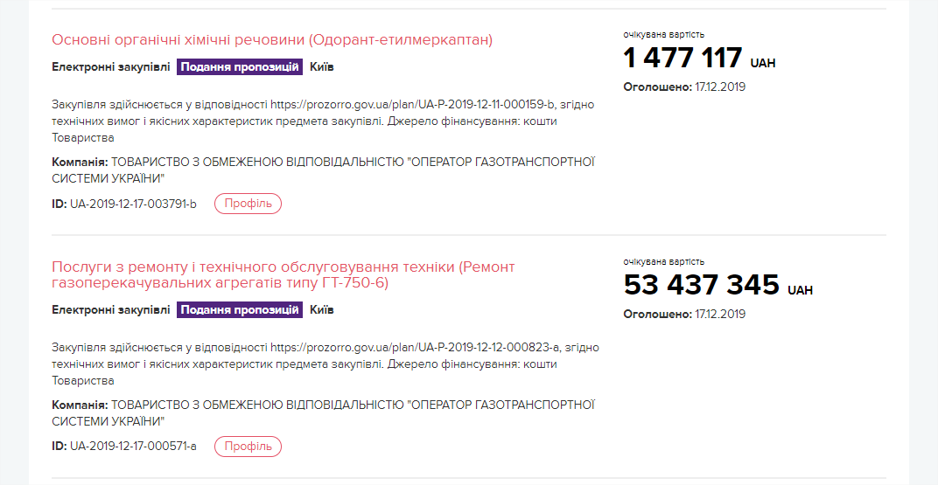
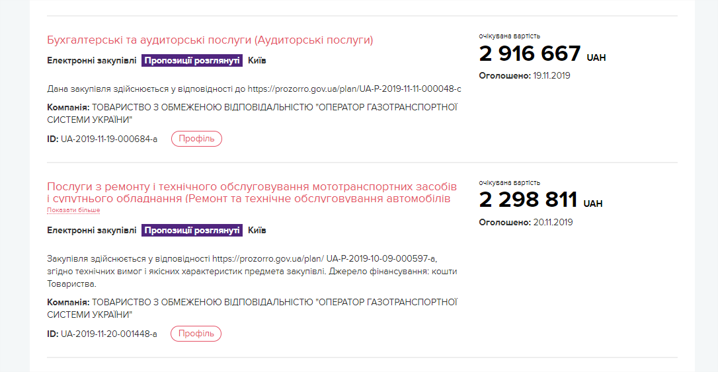
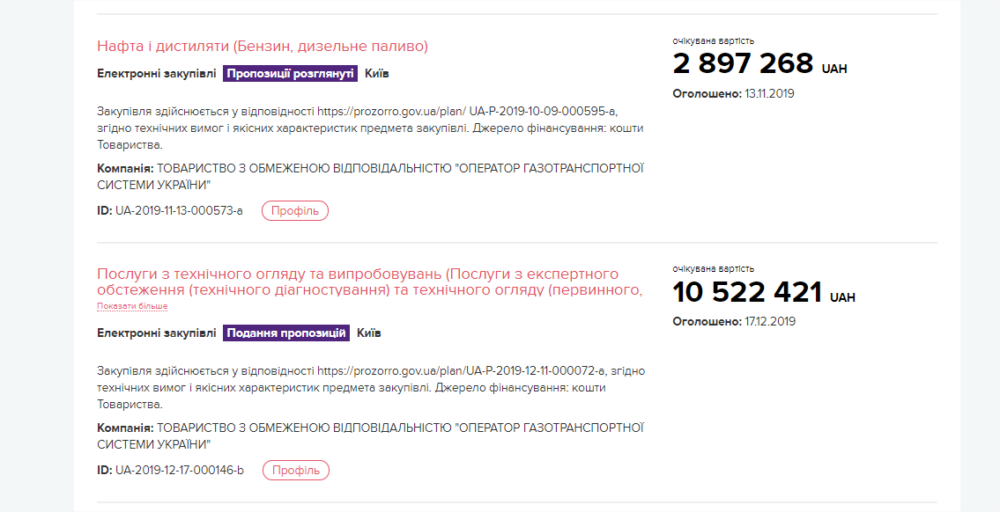
TSO LLC has already started new procurements on Prozorro and invites Ukrainian and international players to participate
100+ tender procedures
already launched by TSO LLC on Prozorro for
~ UAH 9 bln

Slide 8
TSO LLC has own IT environment independent from vertically-integrated undertaking
Split of hardware is completed, starting from 06/12/2019 TSO is responsible for administration of infrastructure and supporting IT services
Hardware
TSO SAP ERP instance created, full administration overtaken by TSO SAP team
TSO SAP iPlatform is administrated by TSO and ready for operation
Licenses transfer agreement between TSO and UTG is prepared and to be signed till 24/12/2019
SAP systems
IT team is fulfilled to support and develop all services
Dispatching systems
Separation of industrial systems completed
Data-flows reconfigured in two separate streams
Other software
Remaining relevant corporate software is replicated in TSO, tested and accepted

Slide 9
Investment program of TSO LLC for 2020 is amounted up to UAH 2.1 bln
Investment program for 2020-2024
(UAH bln)
Investment program was prepared based on zero transit assumption;
Main goals for the next five years:
optimization of GTS to reflect future demand for transportation service
be ready to implement optimization plan starting from 2020
increase automation and improve SCADA
ensure security of supply
increase firm capacity at western border
zero interruptions
decrease maintenance cost and fuel gas consumption
2020
2021
2022
2023
2024
Further decisions on development of UA GTS will depend on
post-2019 transit volumes

Slide 10
Main priorities for the following weeks
To get final certification decision from NEURC, GTS license and tariff
Sign act of transfer state owned assets (EMR Agreements already signed)
Sign act of transfer TSO LLC from UTG to MGU (SPA already signed)
Sing remaining transmission contracts with all DSOs, production companies and regional suppliers
Sing remaining interconnection agreements at all entry/exit points

Slide 11
CHALLENGES FOR 1stQ of INDEPENDENT OPERATIONS
Unauthorized
gas offtake
Ensure SoS
under zero transit
Financing of
working capital
1
2
3
Unresolved problem with unauthorized gas offtake can lead to significant financial instability and put at risk the unbundling process
5 CSs to operate in reverse mode have been upgraded
Storage level at the end of injection – 21.4 bcm
Despite the submitted tariffs to NEURC and share capital increased by inventories, additional initial capital for TSO LLC is needed: ca. EUR M 300 for 2020
New cooperation rules with SSO
Negotiations
with Gazprom
Cost reflective
Tariffs
4
5
6
Signing of TSO-SSO interoperation agreement and establishment of OBA between TSO and SSO.
In needed to book storage capacity for fuel gas and gas for balancing needs
Trilateral negations on transit through Ukraine:
IA and Transmission agreement
transit to Moldova
Changes to IA with Slovakia
Calculation submitted to NEURC.
Waiting for approval on Dec, 24

Slide 12
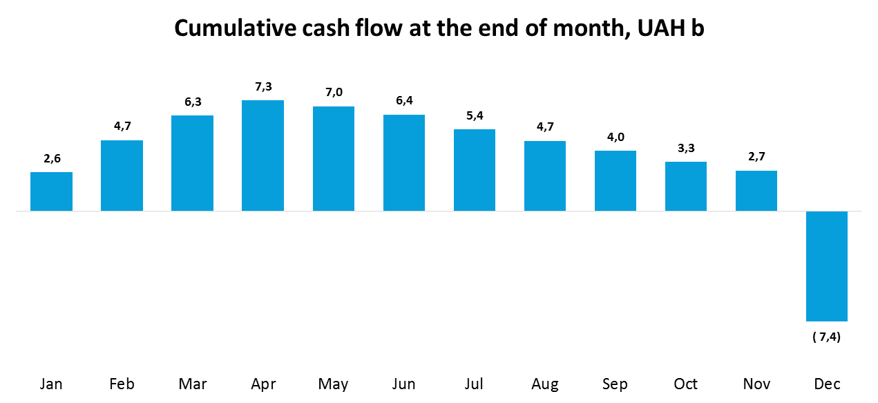
Unauthorized gas offtakes – key risk for independent TSO
If unauthorized offtakes problem is not solved, TSO losses on provision of balancing services are expected to reach UAH 10 – 12 billion – more than 50% of expected revenue from provision of gas transmission services. In this case TSO will face cash deficit at the end of 2020.

Slide 13
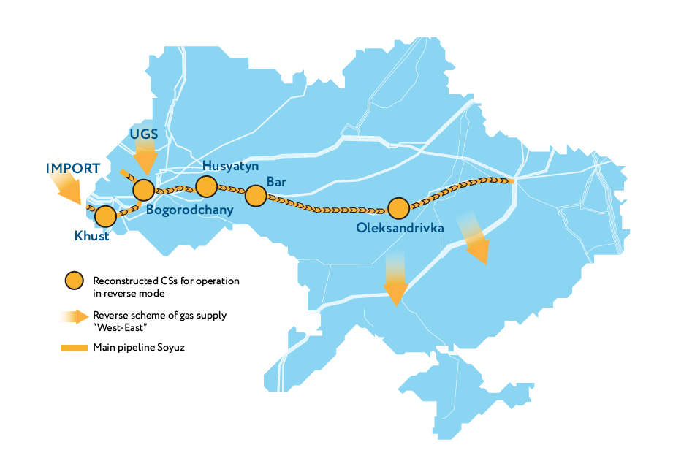
GTS regimes and modernization of compressor stations are ready for reverse mode given zero transit
In the event of transit halt, new TSO is technically ready to ensure supply to domestic consumers by transporting gas from EU countries and UGSFs in West Ukraine.
However, import potential also depends on the gas availability and uninterruptable gas supply arrangements

