Slide 1
“TO STORE TO SUPPLY”
SERVICE OF MONITORING THE STORAGE OF PLEDGED NATURAL GAS (UPDATED VERSION)
Acting General Director S. V. Pereloma
9.11.2020

Slide 2
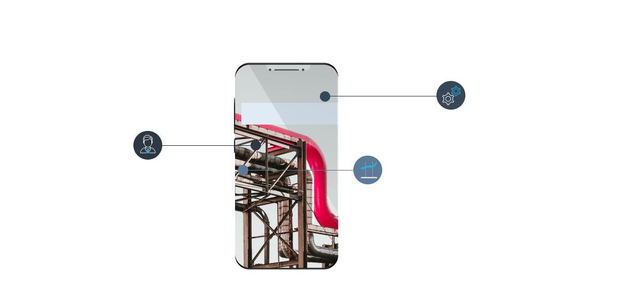
“TO STORE TO SUPPLY”
JSC “UKRTRANSGAS” – GAS STORAGE FACILITY OPERATOR
Capacity of GSFs: 30.9 billion cubic metres
Number of Clients: Residents 712 Non-residents 77 Total 789
JSC “Ukrtransgas”
The GSFs hold as of the beginning of October 2020: 28 bcm Residents 18 bcm including “Customs Warehouse” 1.3 bcm Non-residents 10 bcm including “Customs Warehouse” 10 bcm
2

Slide 3
SERVICE OF MONITORING OF PLEDGED NATURAL GAS
Client
Bank
Aim: the introduction of the service of monitoring of natural gas that is stored in the GSF Operator’s storage accounts as a financial instrument securing the gas owner’s obligations under loan agreements.
GSF Operator
3

Slide 4
Client – GSF Operator
Client - Bank
1. Agreement for storage (injection, withdrawal) of natural gas
2. Loan Agreement, Pledge Agreement
1
2
NEW PRODUCTS – NEW OPPORTUNITIES
FOR THE GAS MARKET PLAYERS
Client - Bank - GSF Operator
Monitoring Agreement
MONITORING OF PLEDGED GAS
3
Bank – GSF Operator
3. Copies of the Pledge Agreement and the Loan Agreement, an Extract from the State Register of Encumbrances over Movable Property
4

Slide 5
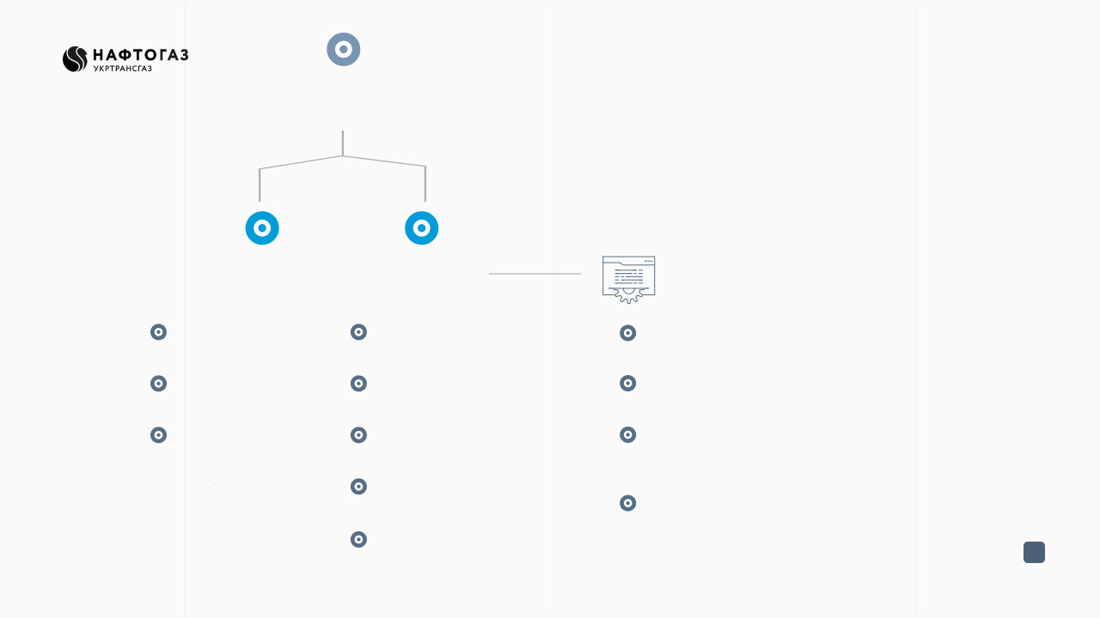
HOW DOES IT WORK?
Monitoring Agreement (MA)
List of documents
Calculation/ Payment
Actions are recorded in the GSF Operator’s I-Platform
Natural Gas Storage Agreement
100% payment of the monthly cost
Blocking of a quantity of natural gas owned by the Client
Pledge Agreement
Price: 0.05% of the collateral value (Pledge Agreement)
Role of the monitoring for the Bank in the I-Platform
Loan Agreement
The gas stays in the storage account (in the Client’s ownership)
Enquiries from the pledgee (Bank) regarding the current status of the gas quantity that is the subject of the MA
Selection of the payer under the MA – the Bank or the Client
The Client may dispose of the gas subject to the Bank granting permission and approval
The Bank may pay the invoice on behalf of the Client
5

Slide 6
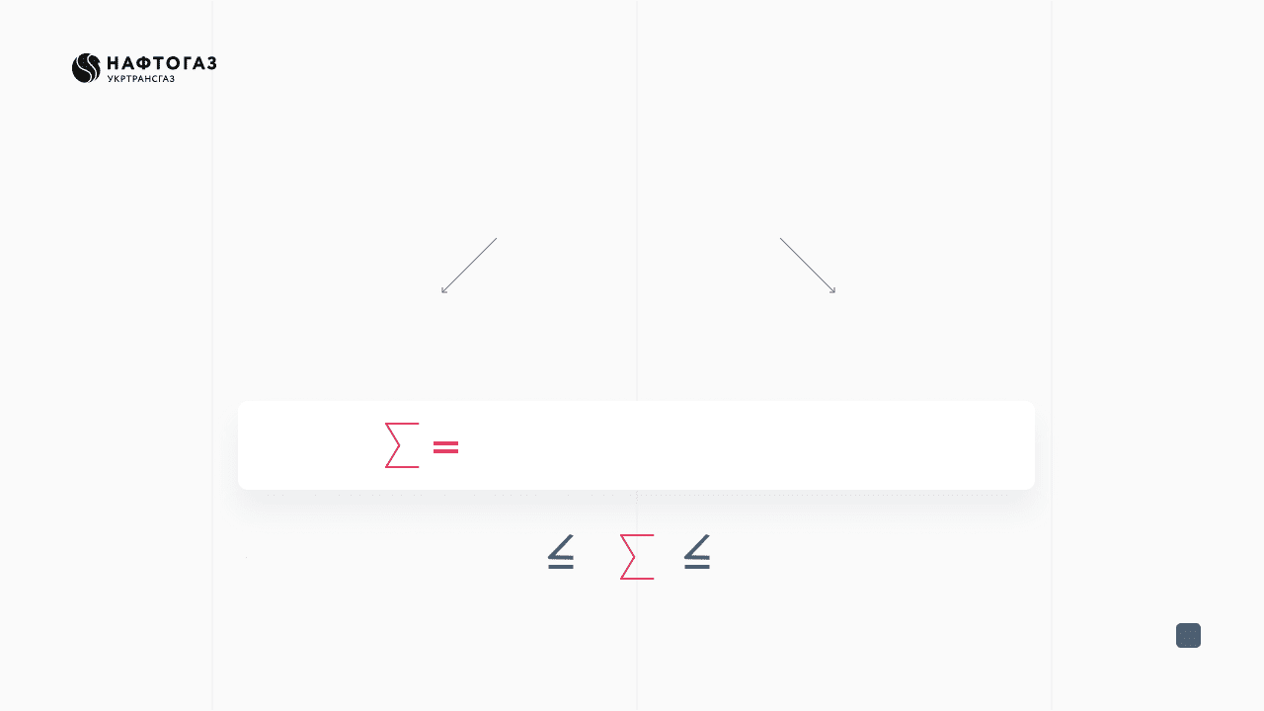
CALCULATION / PAYMENT
100% prepayment of the monthly cost of the services, subject to VAT (20%)
or
Bank
Client
0.05% of the collateral value (pledge agreement)
UAH 18 thousand
UAH 120 thousand
* change of value to be notified not later than 31 calendar days in advance
6

Slide 7
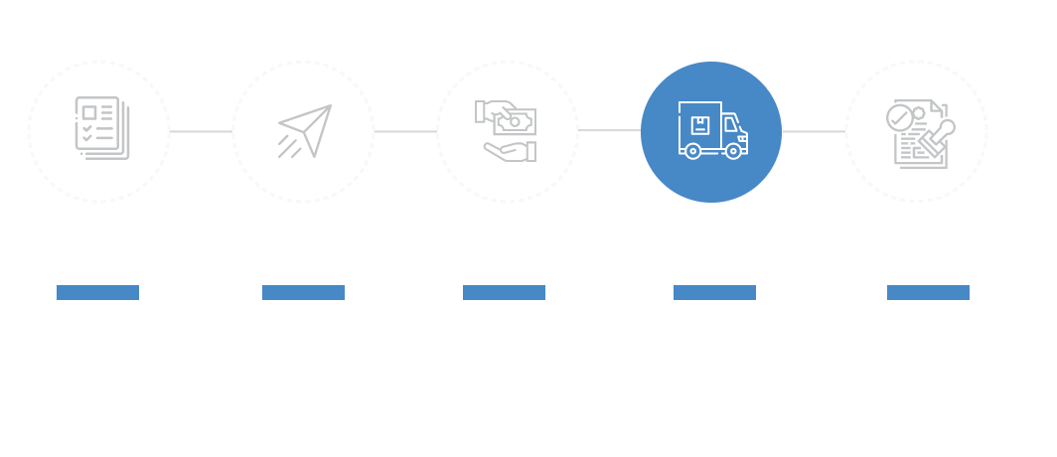
PROCEDURE
First month
1. Monitoring Agreement
2. Invoice
4. Provision of the service
5. Service Delivery Certificate
3. Payment
Execution of a tripartite monitoring agreement between the GSF Operator, the Bank and the Client
The GSF Operator, within 2 business days, issues an invoice for the payment of the service and sends the same to the Bank/Client. Original, for the Client, a copy, for the Bank.
The Client/Bank pays the invoice within 2 business days. * If the Client fails to pay the invoice the Bank is granted the right to pay (4 days)
Monitoring of the pledged gas on the I-Platform
The GSF Operator issues and sends a bilateral Service Delivery Certificate for signing
7

Slide 8
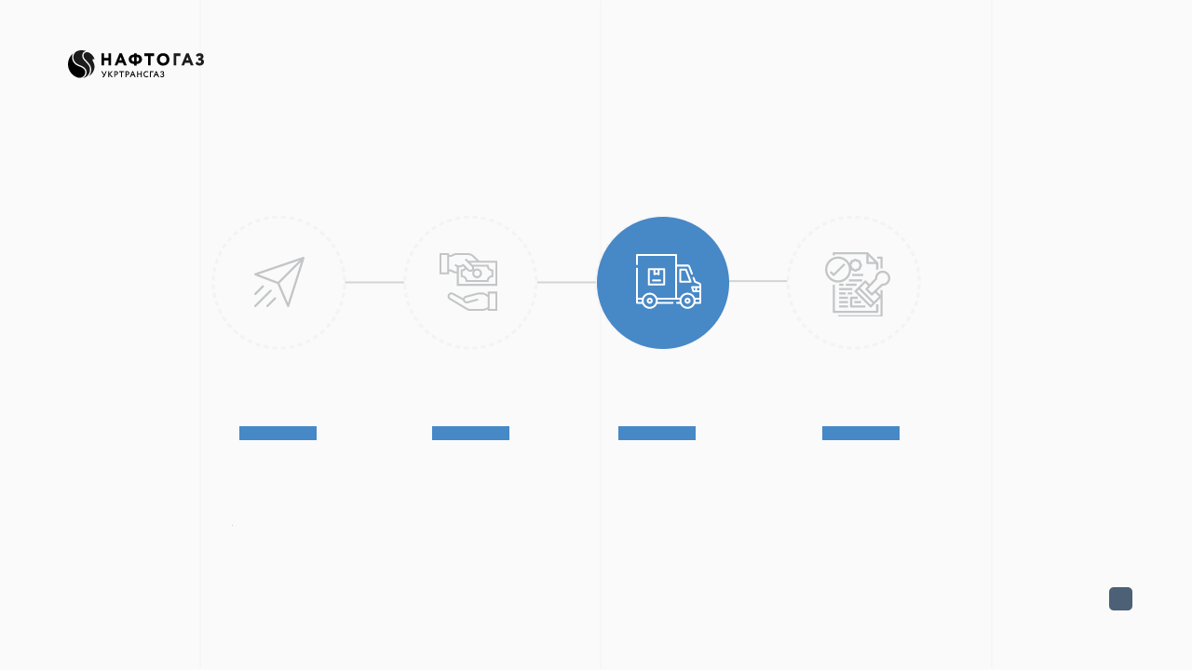
PROCEDURE
Continuation, where the service is provided for longer than 1 month
1. Invoice
2. Payment
3. Provision of the service
4. Service Delivery Certificate
The GSF Operator, before the 20th day of the month preceding the month in which the service is provided issues an invoice for the payment of the service and sends the same to the Bank or the Client
The Client or the Bank pays the invoice within 2 business days. * If the Client fails to pay the invoice the Bank is granted the right to pay (4 days)
Monitoring of the pledged gas on the I-Platform
The GSF Operator issues and sends a bilateral Service Delivery Certificate for signing
8

Slide 9
The GSF Operator must be notified in writing of any changes of the natural gas quantity that is the subject matter of the Monitoring Agreement/Supplement to the Monitoring Agreement, subject to mandatory execution of an Additional Agreement.
ADDITIONAL AGREEMENT
9

Slide 10
Thank you for your attention!
Contacts: front-office@utg.ua tel. +38 (044) 299-73-20 +38 (044) 299-73-31 +38 (044) 299-73-43

